Slide 1

Morning Assistant
Devin Chen, Logan Landrum, Andrew Stoycos, Nick Thomas

Slide 2
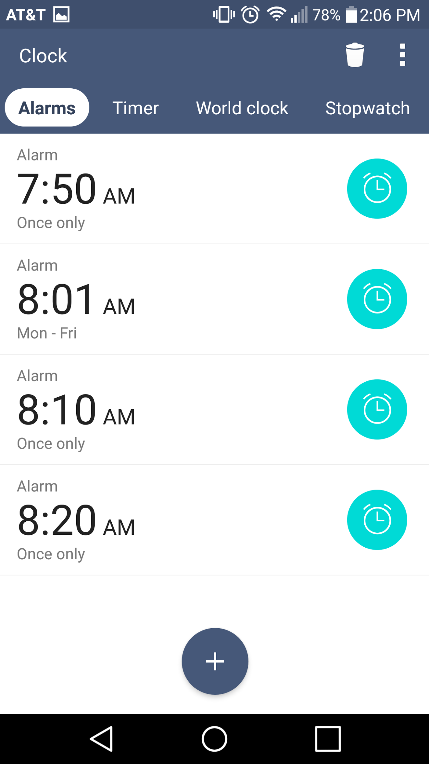
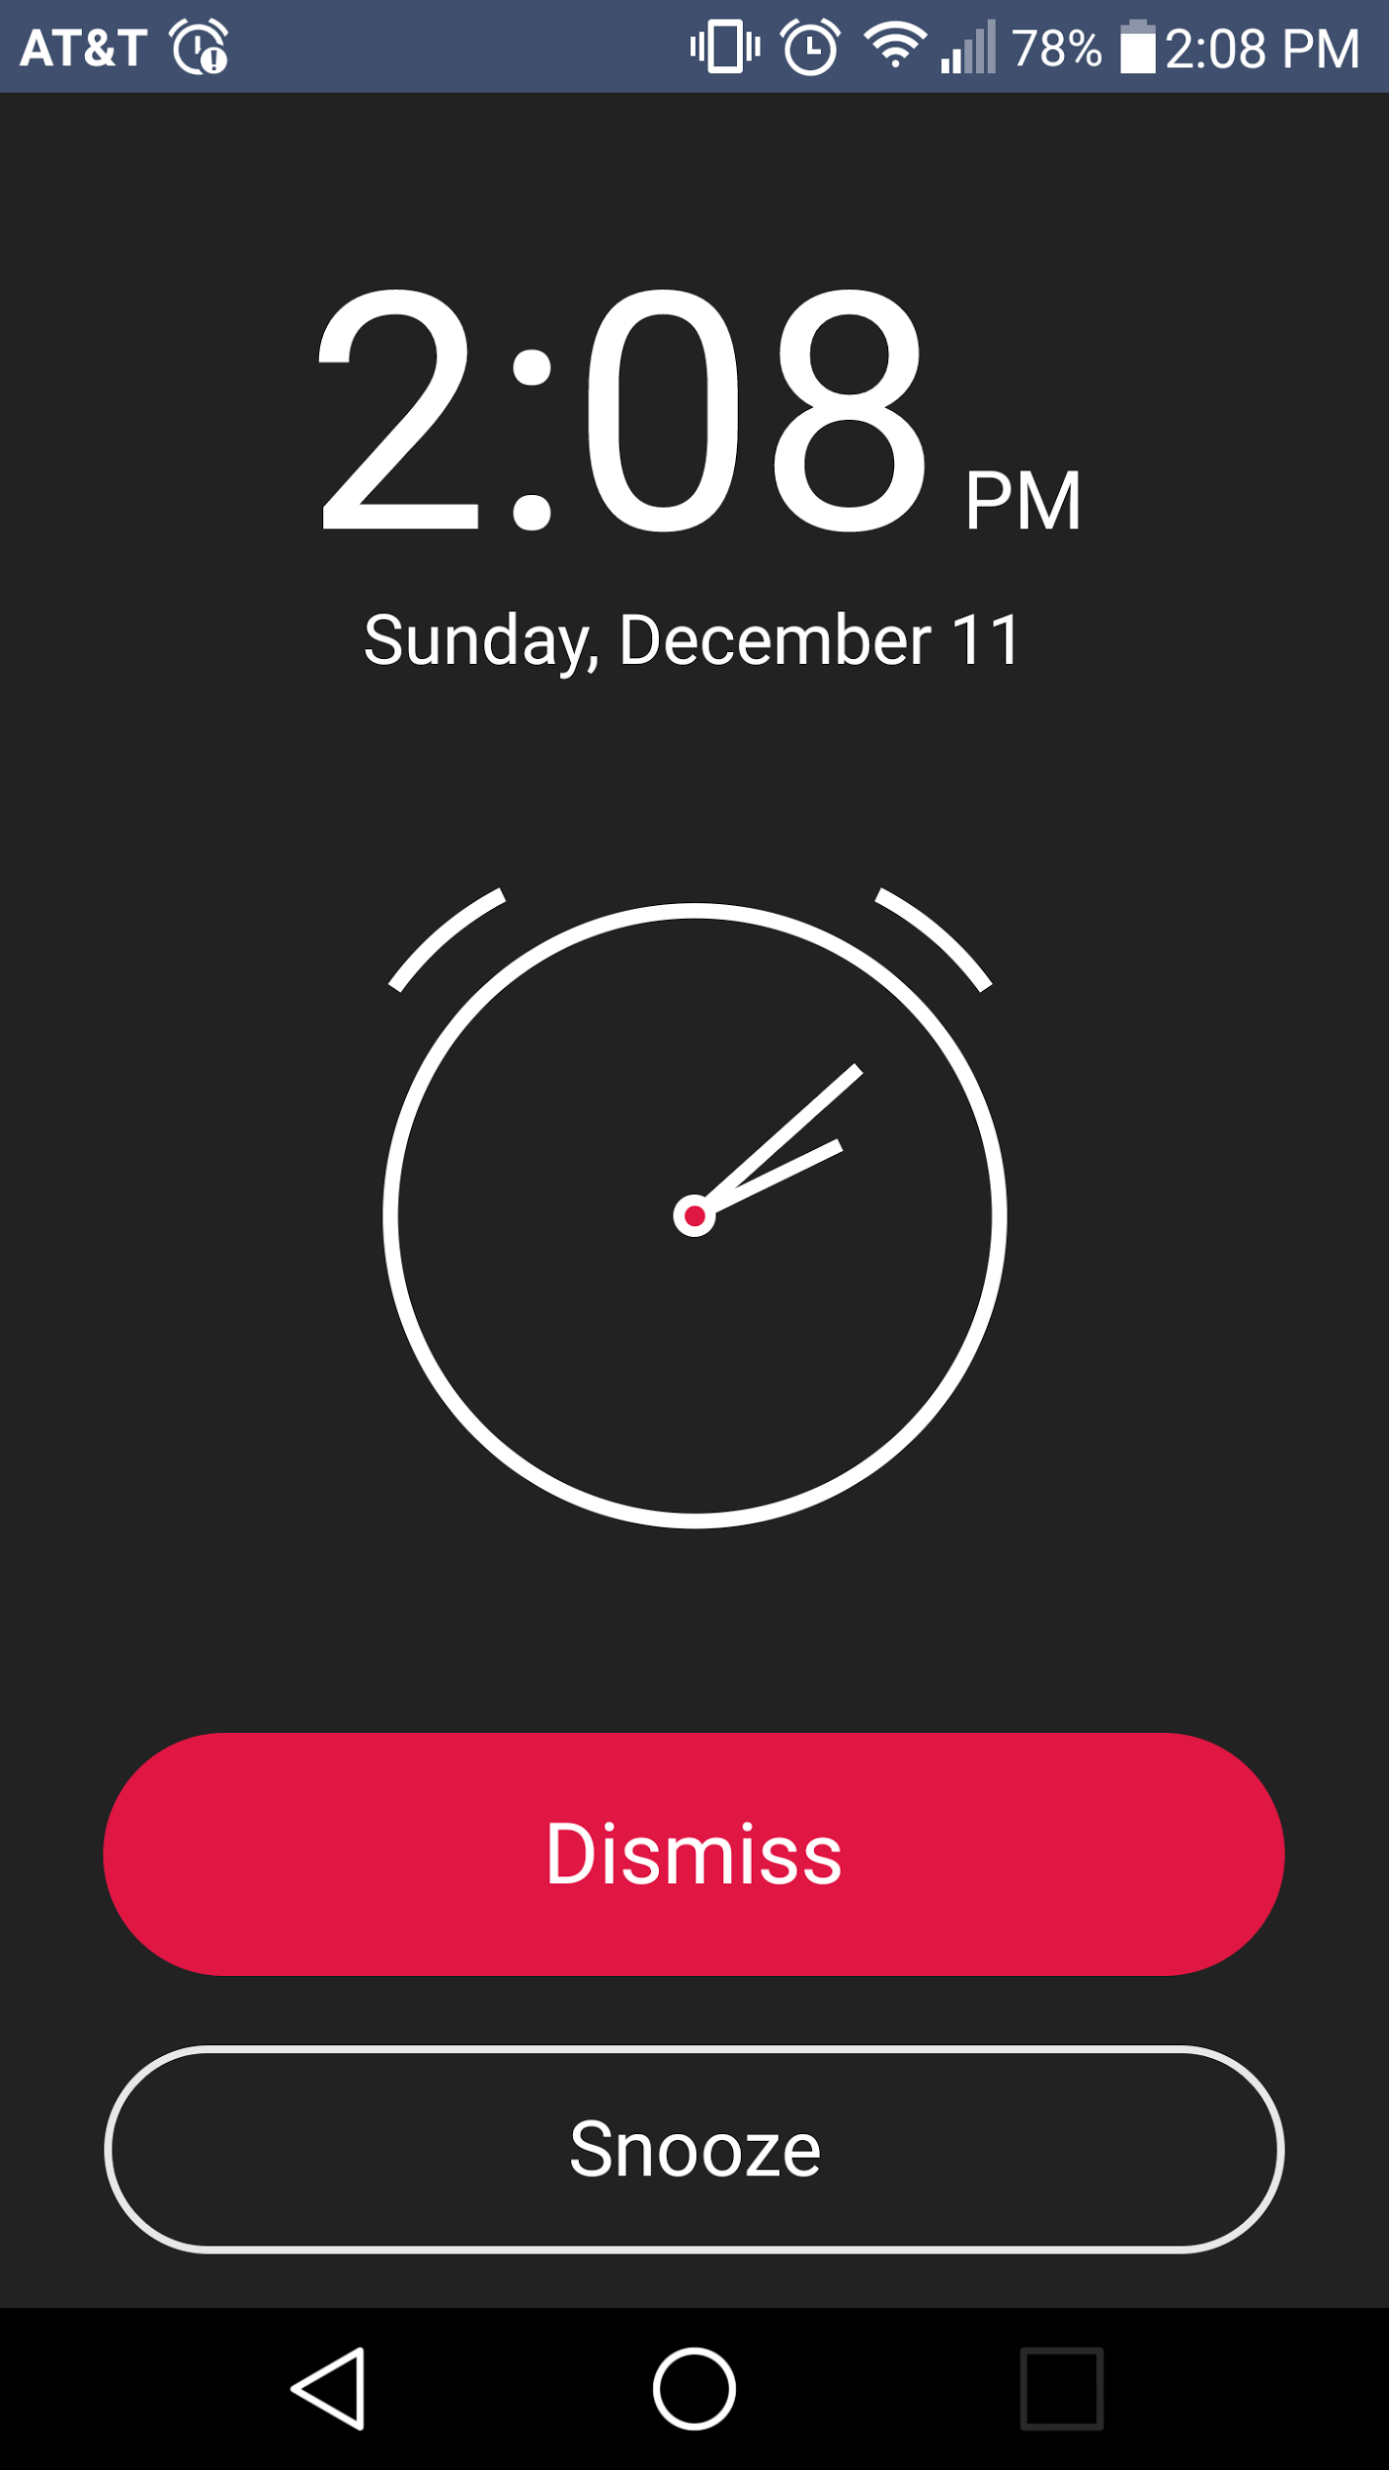
The Competition
Do you ever just click the snooze button over and over?

Slide 3
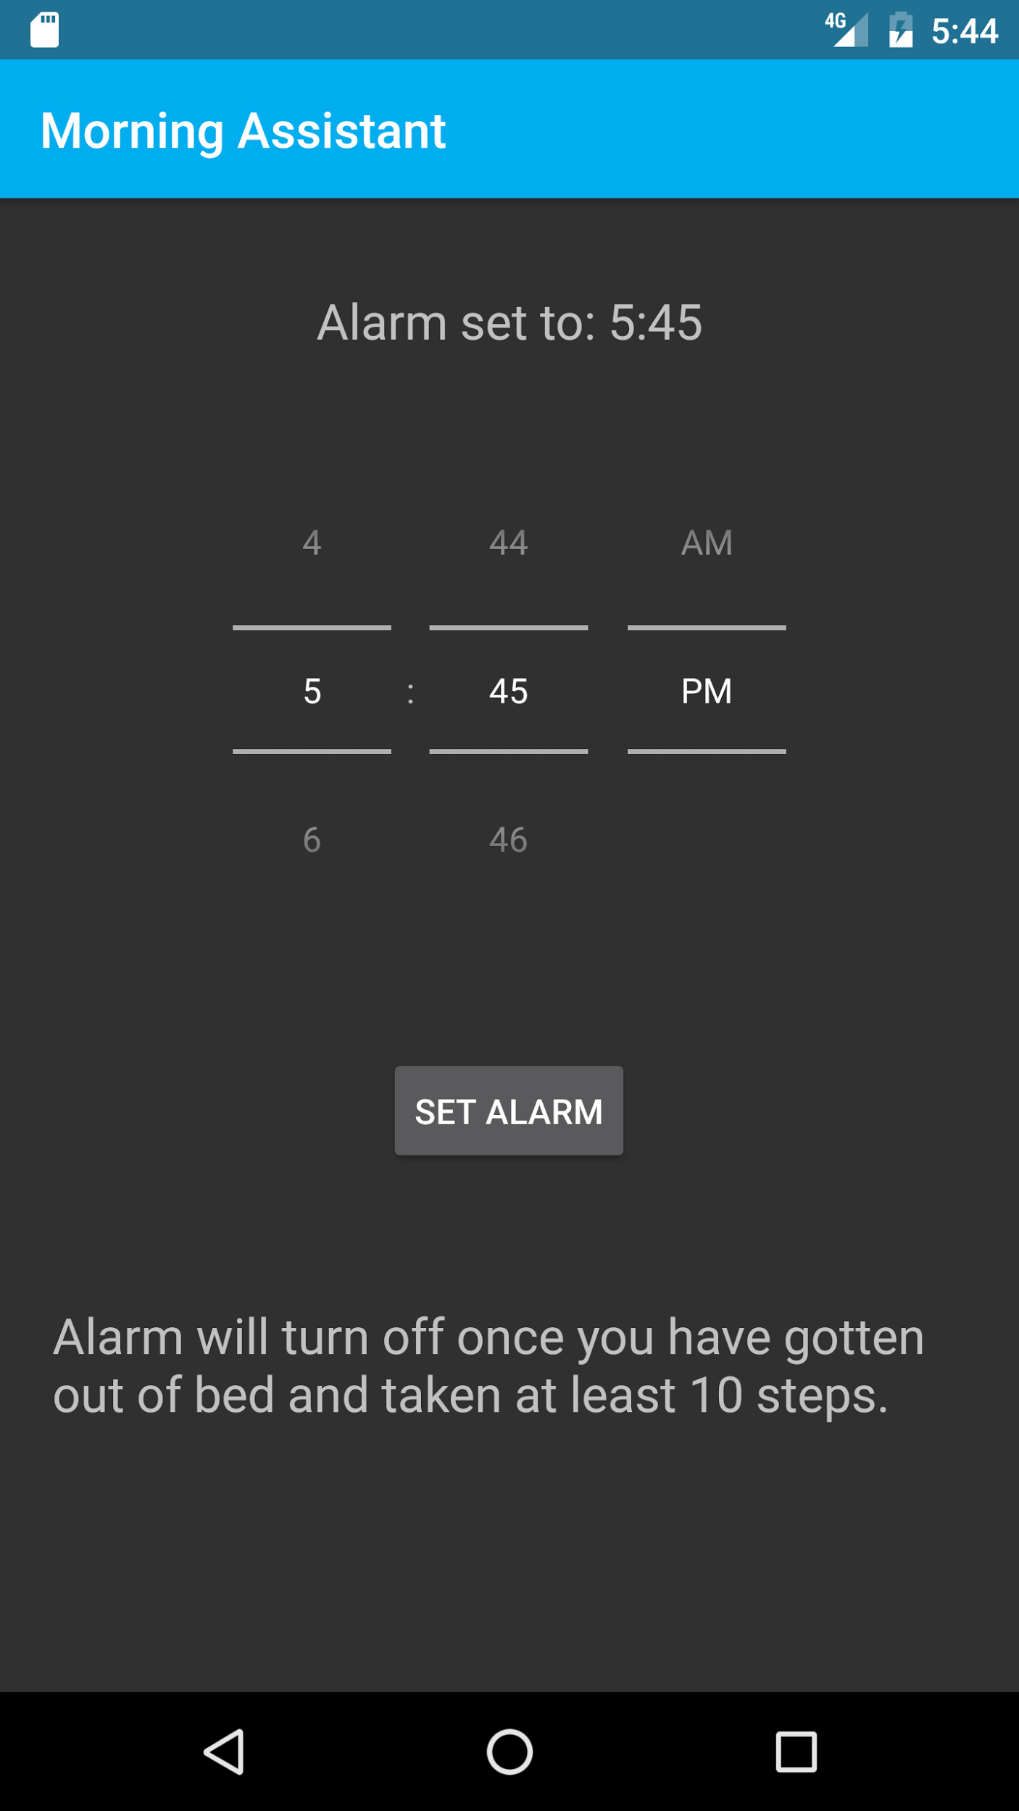
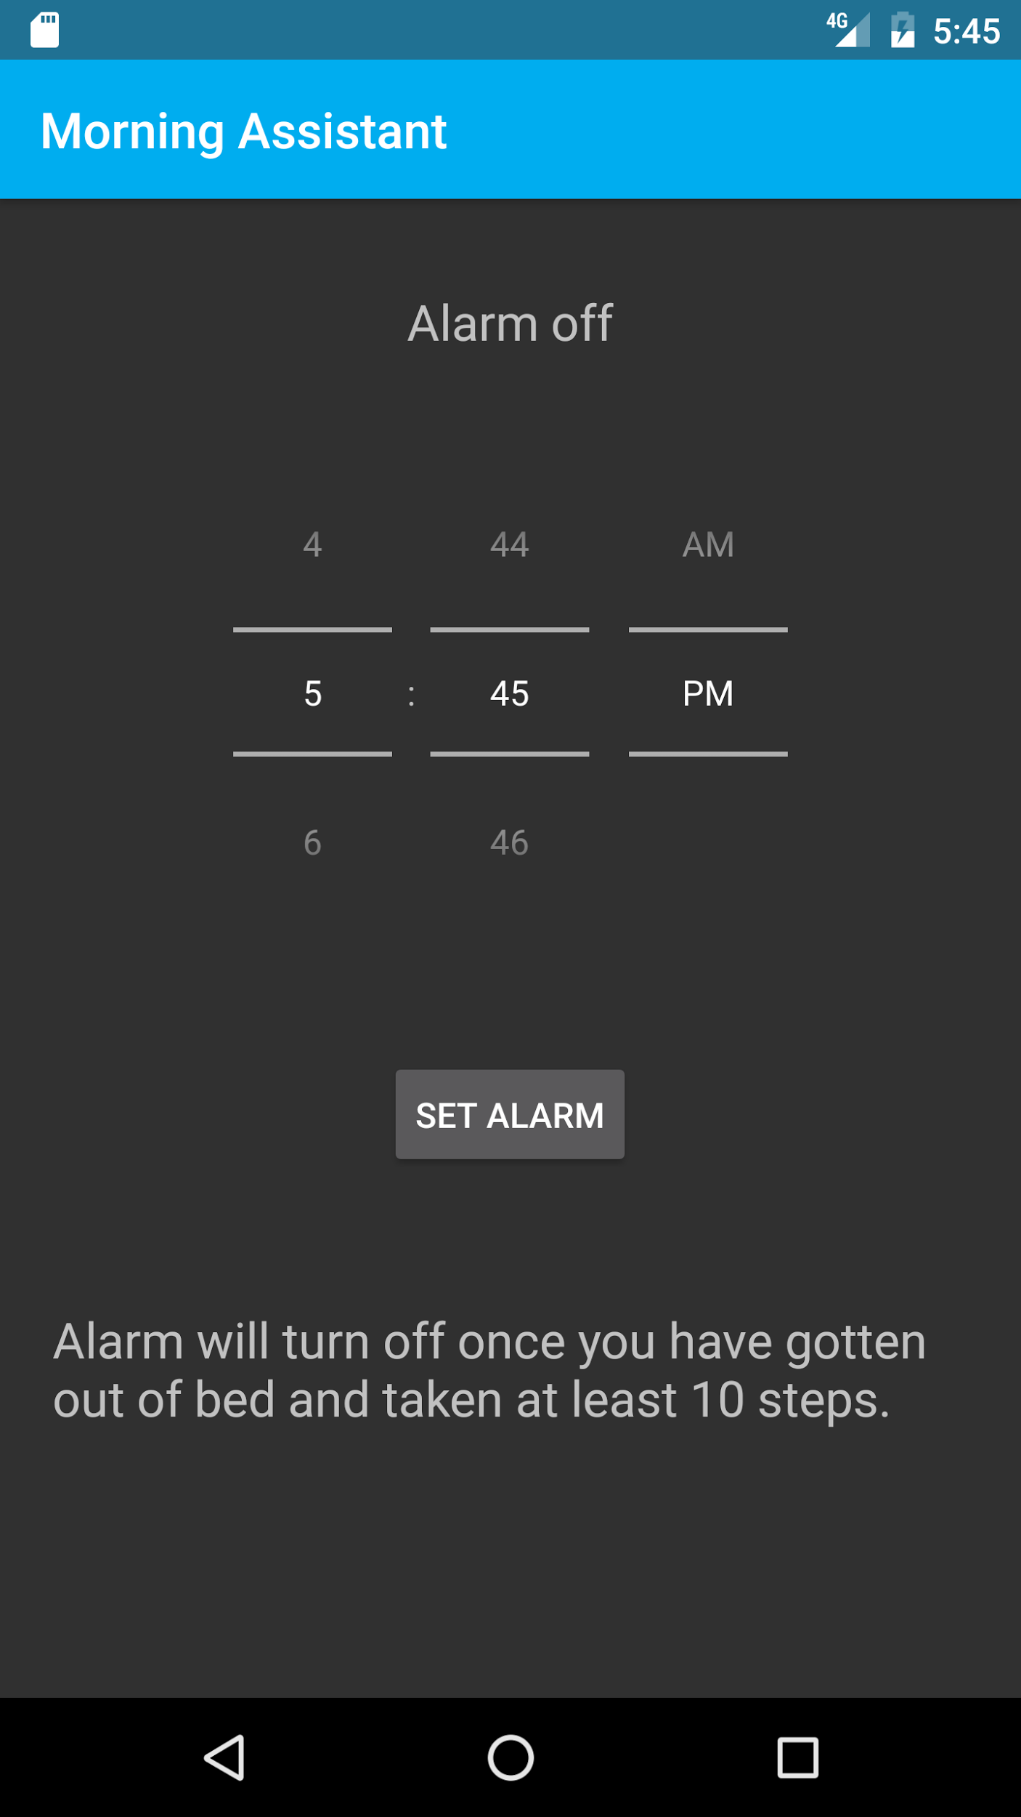
What Makes us Better?
No longer will your Alarm clock Fail to wake you up
Snooze NOT an option
Morning Assistant makes you get out of bed in order for the alarm to turn off
Ten steps required to turn off Alarm

Slide 4
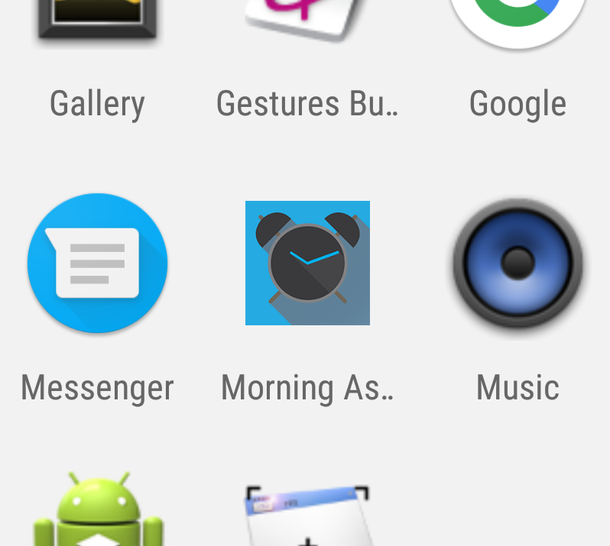

Stylish APK shortcut leads the User into the application

Slide 5


How it Works

Slide 6
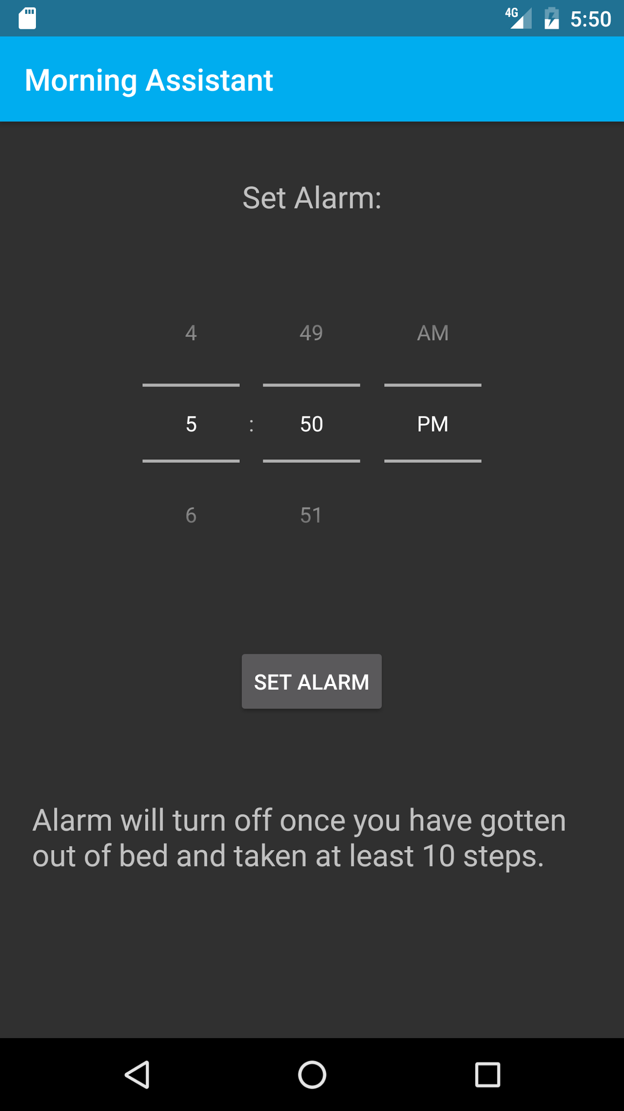
Various Objects Allow user interaction
TextView
TimePicker
MainActivity.Java
Main class which executes all major functions
Button

Slide 7
TimePicker Object
Allows User to Input Alarm Time And saves it to a Calendar Object
TimePicker
Calendar Object
Stores Time input
Alarm Manager
Tells the Phone to Wake up at specified Time

Slide 8
Button Object
Sets Alarm, Creates a Pending Intent which is later initialized by Alarm Manager
Utilizes classes
MainActivity
AlarmReceiver
RingtonePlayingService

Slide 9
TextView
Object
This Object Updates the User on the State of the application

Slide 10
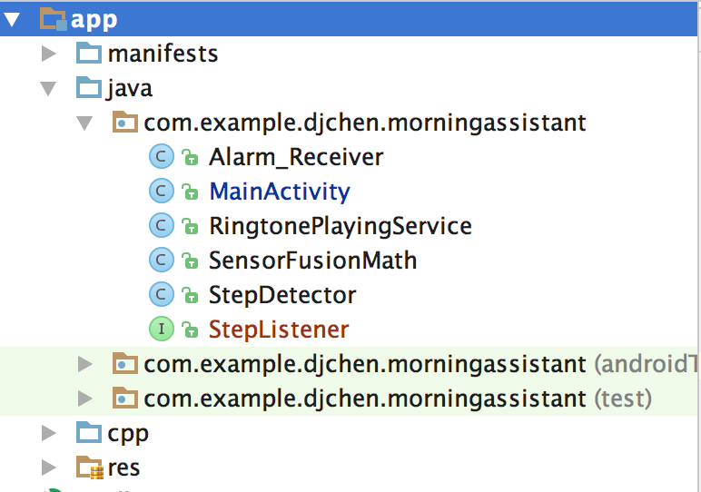
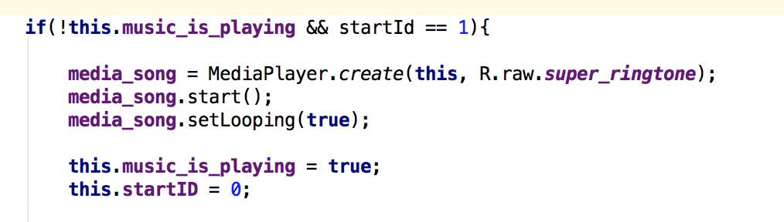
MainActivity
Set Alarm:
Button
Alarm receiver
Receives the Pending Intent when it is time for the Alarm to activate
Sends Broadcast
RingTonePlaying Service
Activates the Mediaplayer
to play the alarm mp3

Slide 11
Step Counter
Counts steps taken by the user. Once 10 steps have taken, the pendingintent is cancelled and the alarm is turned off.
Utilizes
MainActivity
StepListener
SensorFusionMath
StepDetector

Slide 12

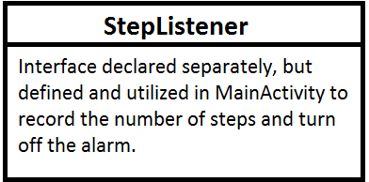

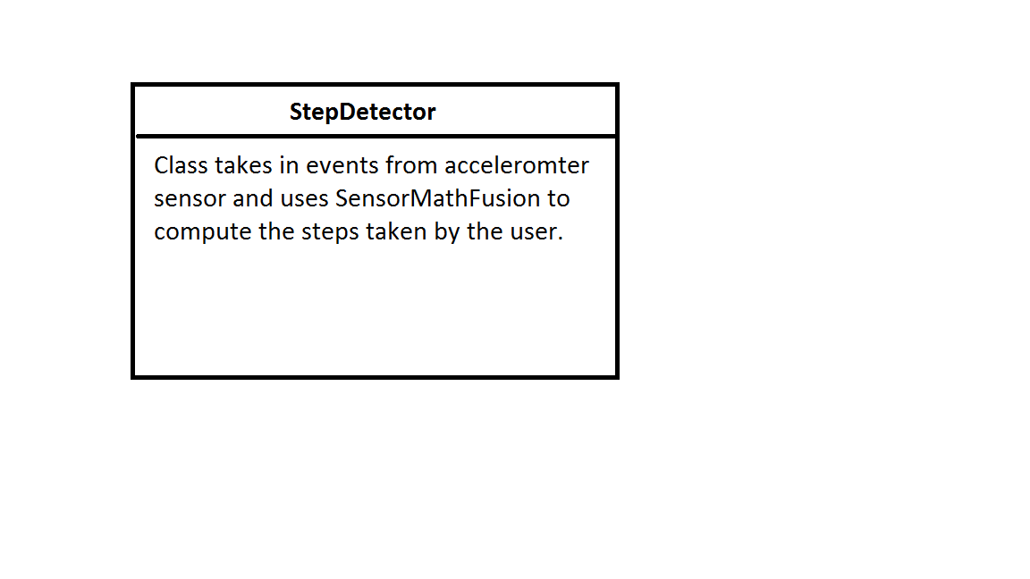
Step Counter: Classes Used

Slide 13
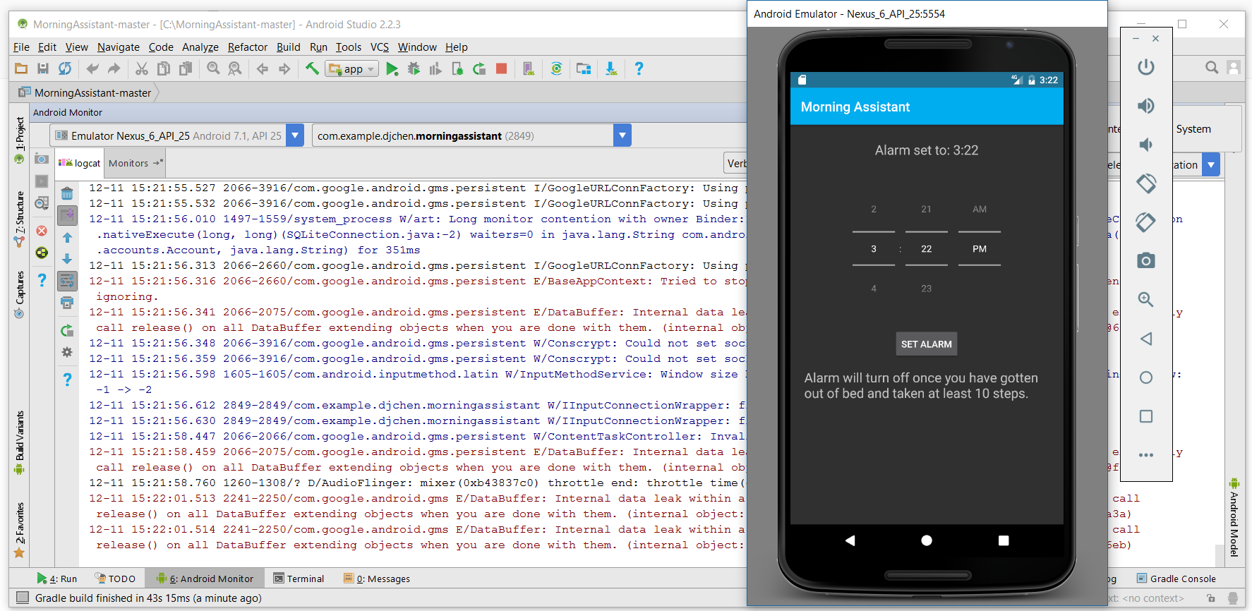
Checking the Steps
Running the emulator Next to the log, the Amount of steps being Taken can be monitored

Slide 14
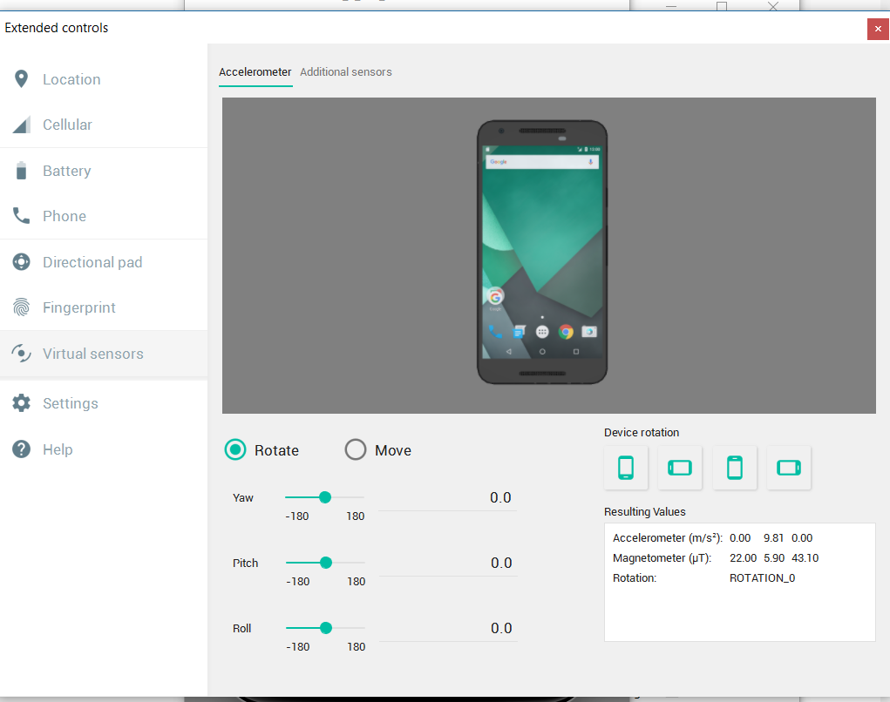
Checking the steps II
When the alarm goes off, the emulated phone can be moved, setting of its virtual sensors.

Slide 15
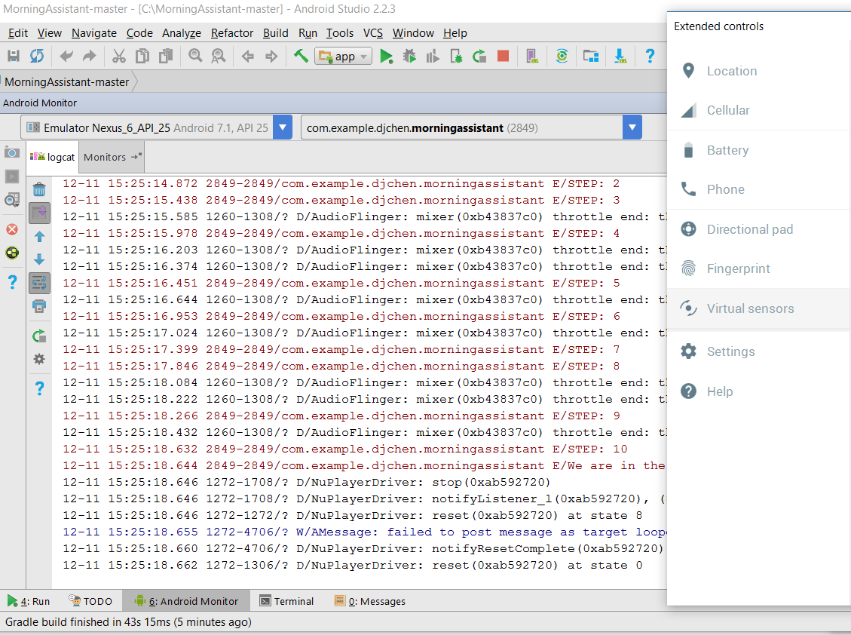
Checking the Steps III
As the phone moves, the log outputs the number of steps until ten steps have been taken, at which point the alarm is turned off.

Slide 16
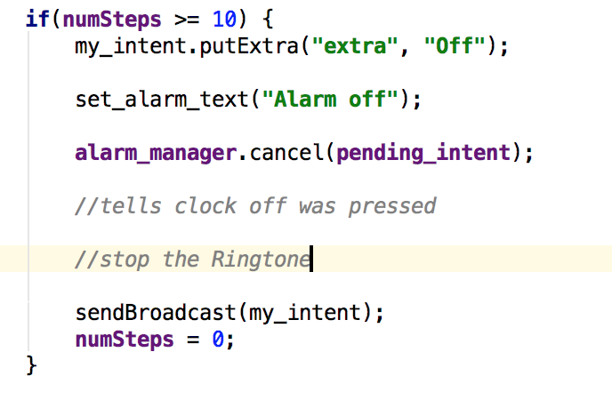
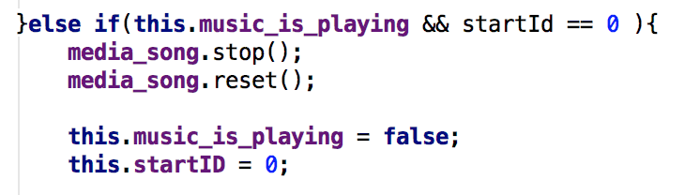
Alarm Off:
10 Steps
MainActivity
Alarm manager
Cancels Pending Intent
after 10 steps
Sends Broadcast
RingtonePlaying Service
Deactivates the Media player and resets the song

Slide 17
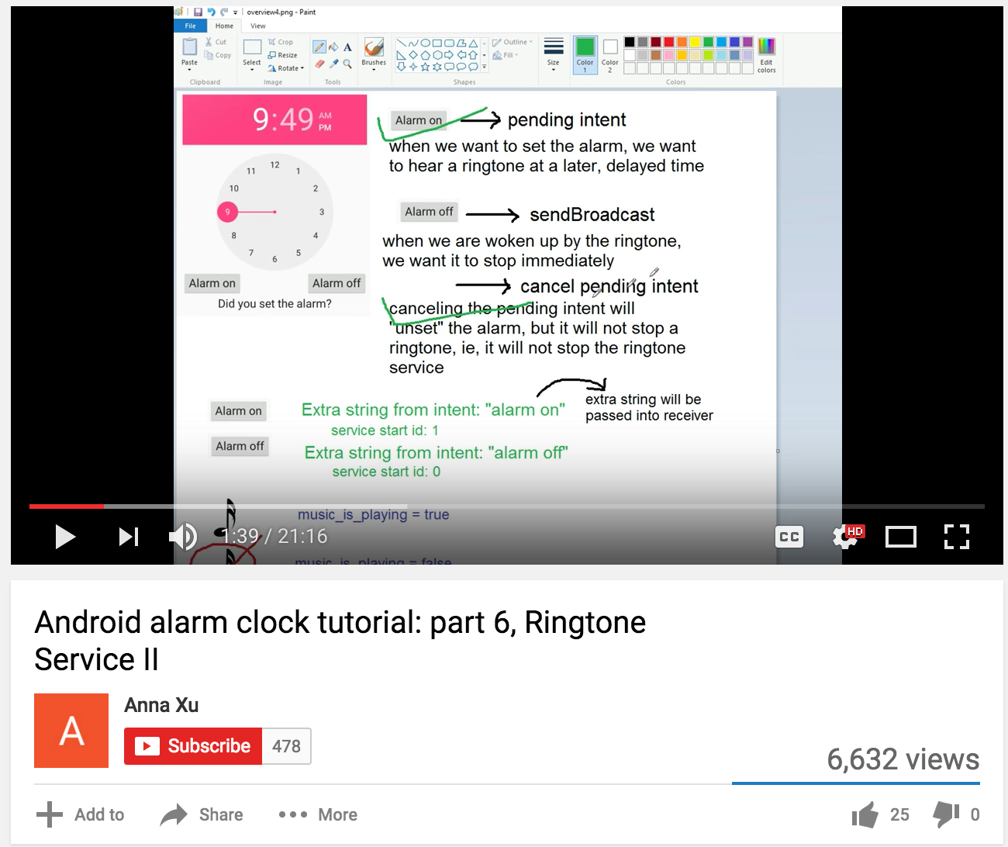

Resources
Android Studio user guide
Youtube tutorials
Envato Tuts+ How to’s
Google Play Services

Slide 18
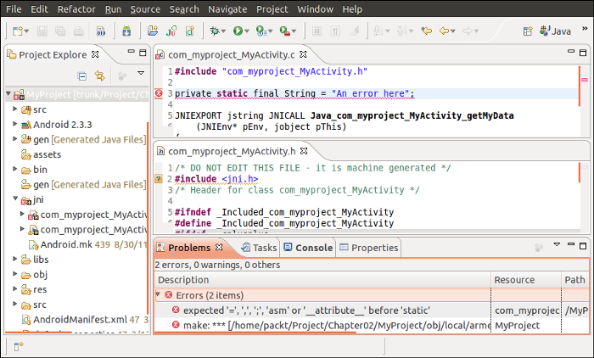
Challenges
Time Constraints
Steep Android/Java learning curve
API and connection to Google Play services
Utilization of Internal Sensors

Slide 19


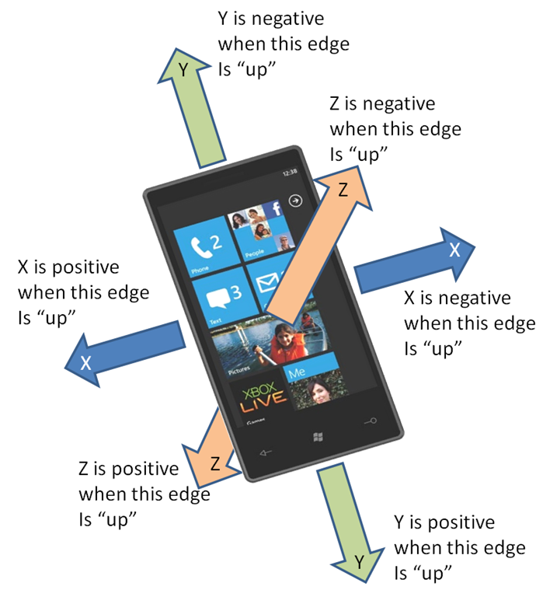

For the Future
Improve use of accelerometer
Implement Google Play Location Services successfully
Improve functionality when app is running in the background
Add options for alarm music/tones

Slide 20

Final Thoughts
Our application is useful among a wide demographic (people who hate mornings, typically college students)
It is designed to be simple and easy to use
It doesn’t crash and (mostly) does what it’s supposed to in practice, so count your blessings I guess
Implementing GPS is, like, stupid hard

